Slide 1
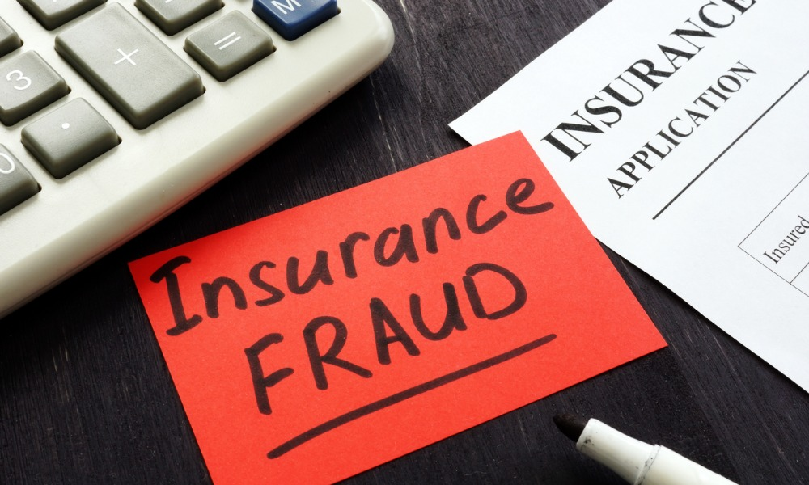

Insurance Claims Project
Kennety Mashishi

Slide 2
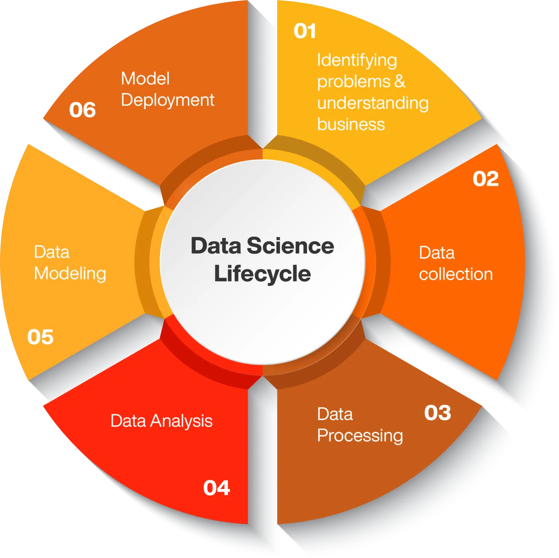
Identifying fraudulent claims using machine learning

Slide 3
Background
Insurance fraud costs the industry billions annually
African insurance market valued at $45B (2017)
Only represents 1% of insured catastrophe losses globally
Challenge: Identify potentially fraudulent claims early
Impact: Reduce financial losses, protect legitimate customers

Slide 4
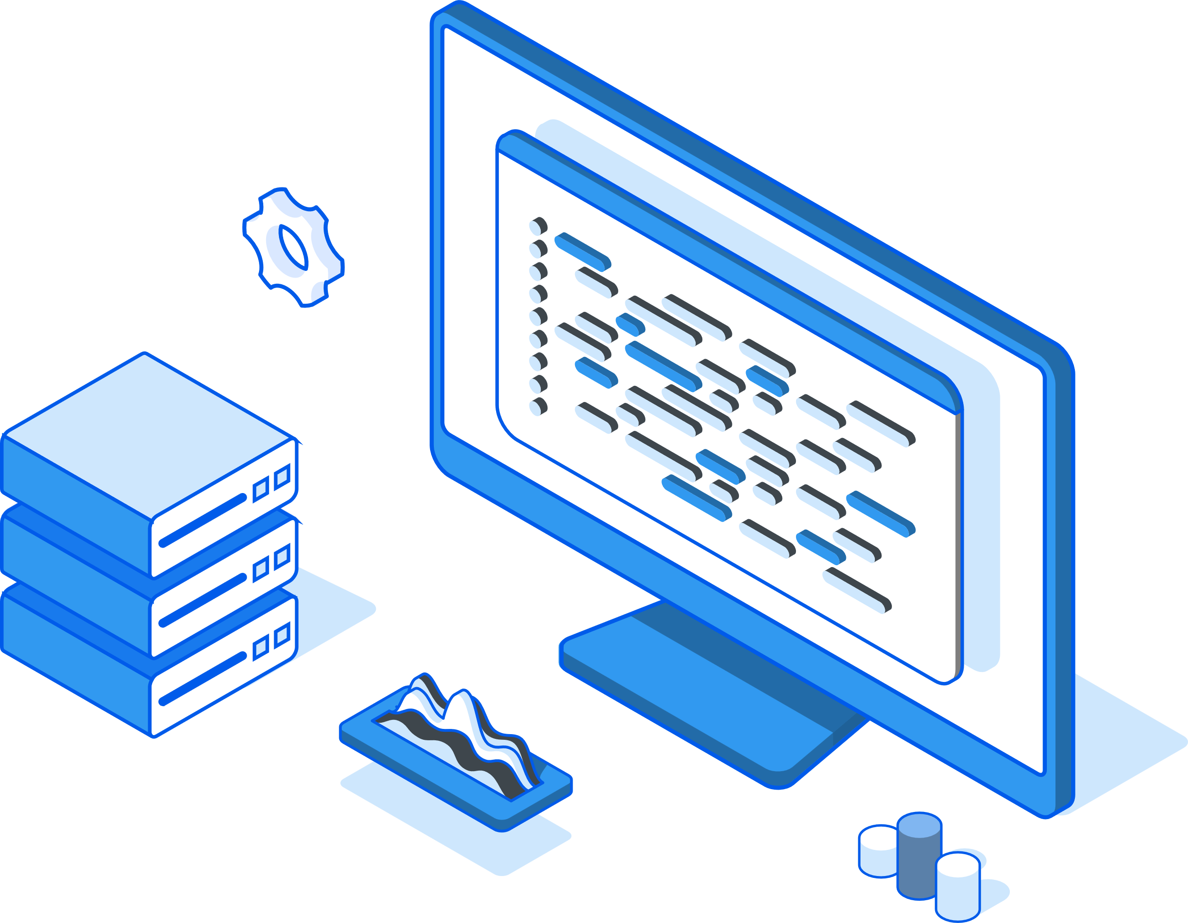
Data Collection & Processing
1,000 insurance claims records
Features (policy, customer, incident, claim details)
Target variable: fraud_reported (Y/N)
24.7% fraudulent claims (imbalanced dataset)
Data cleaning: handled missing values in specific columns
Feature scaling: StandardScaler for numerical features
Feature encoding: One-hot encoding for categorical variables
Train-test split: 75/25 with stratification to maintain fraud ratio

Slide 5
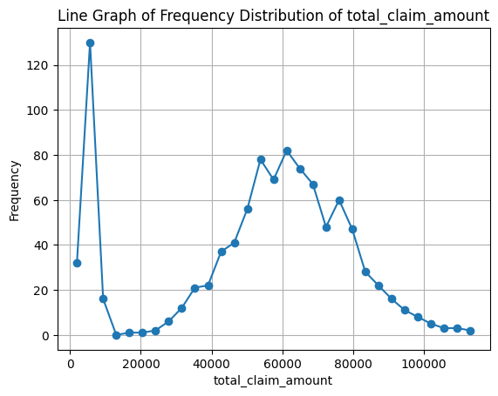
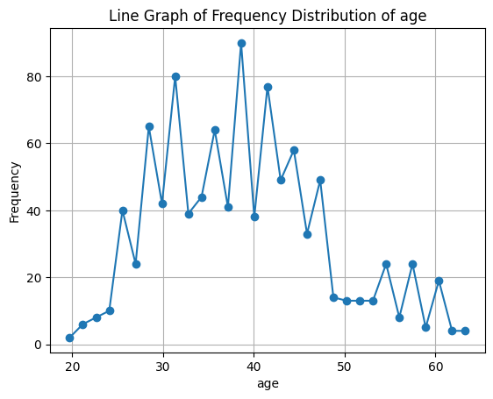
Data Analysis
Age distribution (25-45 years)
Peak late 30s/early 40s
Similar patterns in vehicle claims
Lower ranges for injury and property claims
Bimodal distribution in total claims

Slide 6
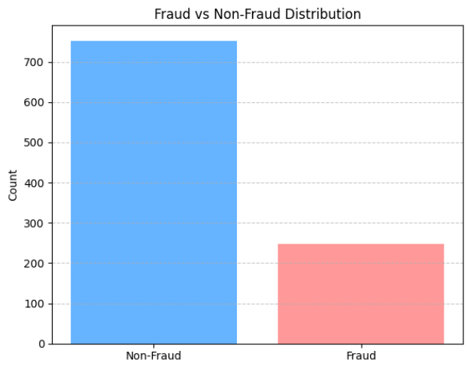
Data Analysis
Imbalanced Data
Majority class: Non-Fraud Cases
75% non-fraud vs. 25% fraud
Need for special handling in modeling

Slide 7
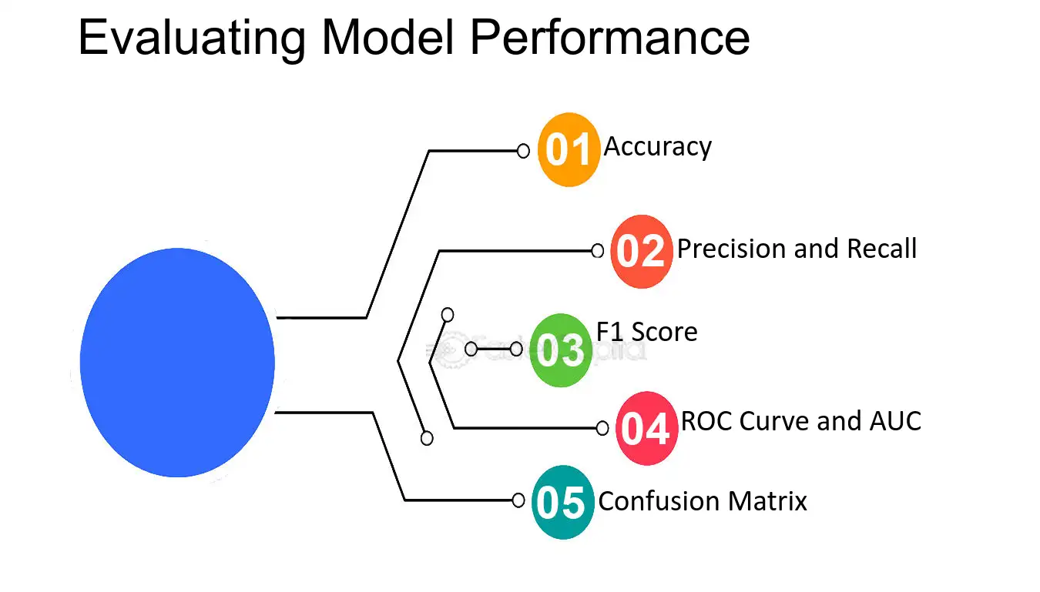
Data Modeling
Class weighting (giving fraud cases more importance)
Metrics: accuracy, precision, recall, F1, ROC AUC
Models tested: Logistic Regression, Random Forest, Gradient Boosting, Neural Network

Slide 8
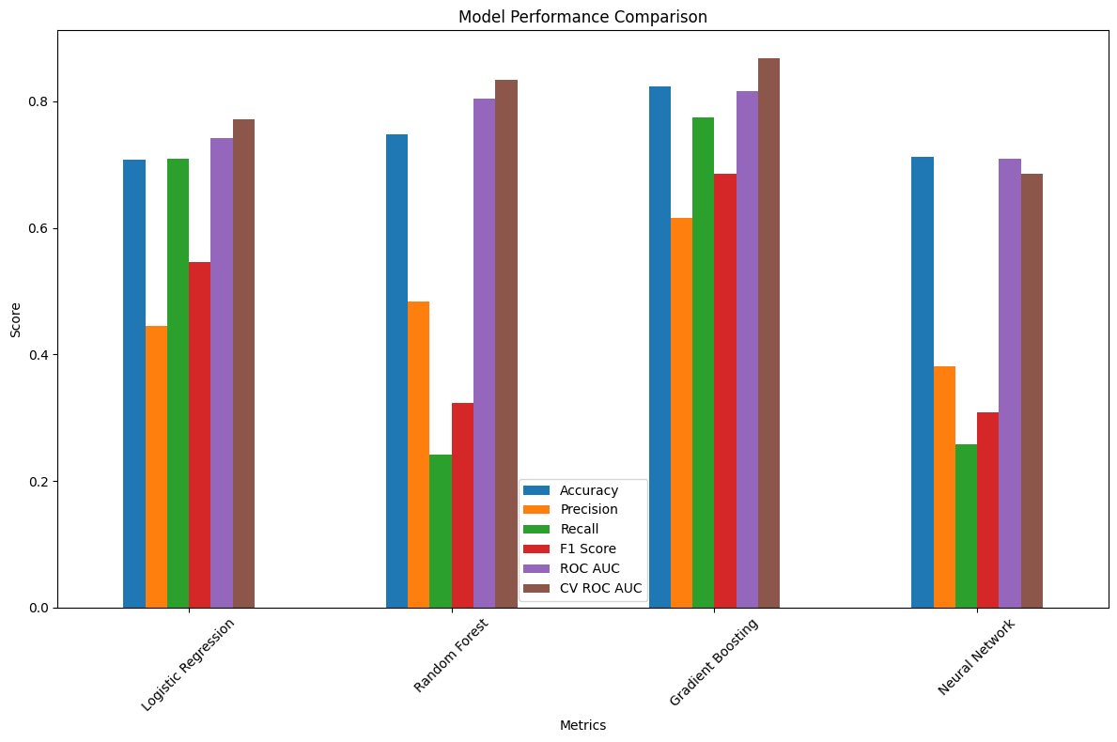
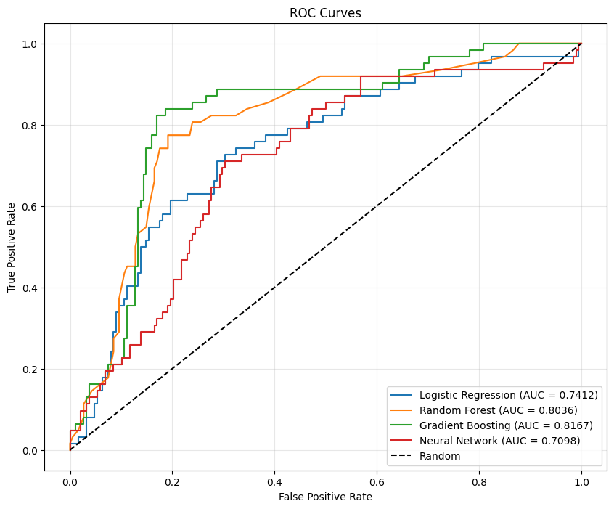
Data Modeling – results/ comparison
Gradient Boosting is the best model
Accuracy: 82.4% Precision: 61.5% Recall: 77.4% F1 Score: 68.6% ROC AUC: 81.7%

Slide 9
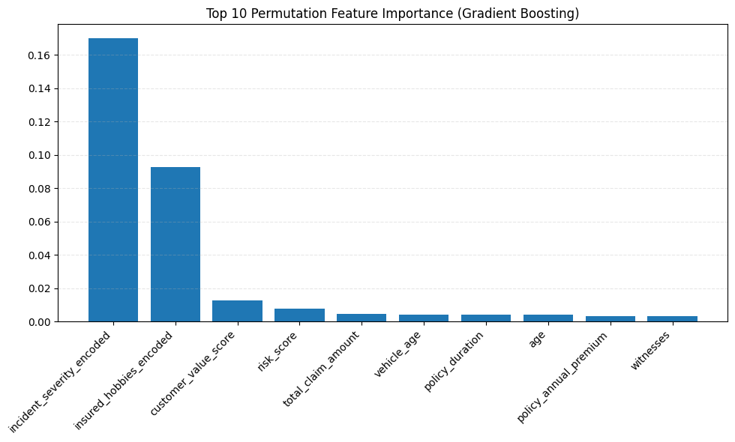
Data Modeling – Feature Importance
What Drives Fraud Predictions?
incident_severity_encoded (strongest predictor)
insured_hobbies_encoded (second strongest) … Interesting insight.

Slide 10

Closing Remarks
Our precision scores were lower than ideal across all models (Gradient Boosting: 61.5%), meaning we're still flagging some legitimate claims as fraudulent. This is the trade-off for catching more fraud.
Potential to save millions annually.
Future Work ?

Slide 11
Thank You !

